Slide 1


Slide 2
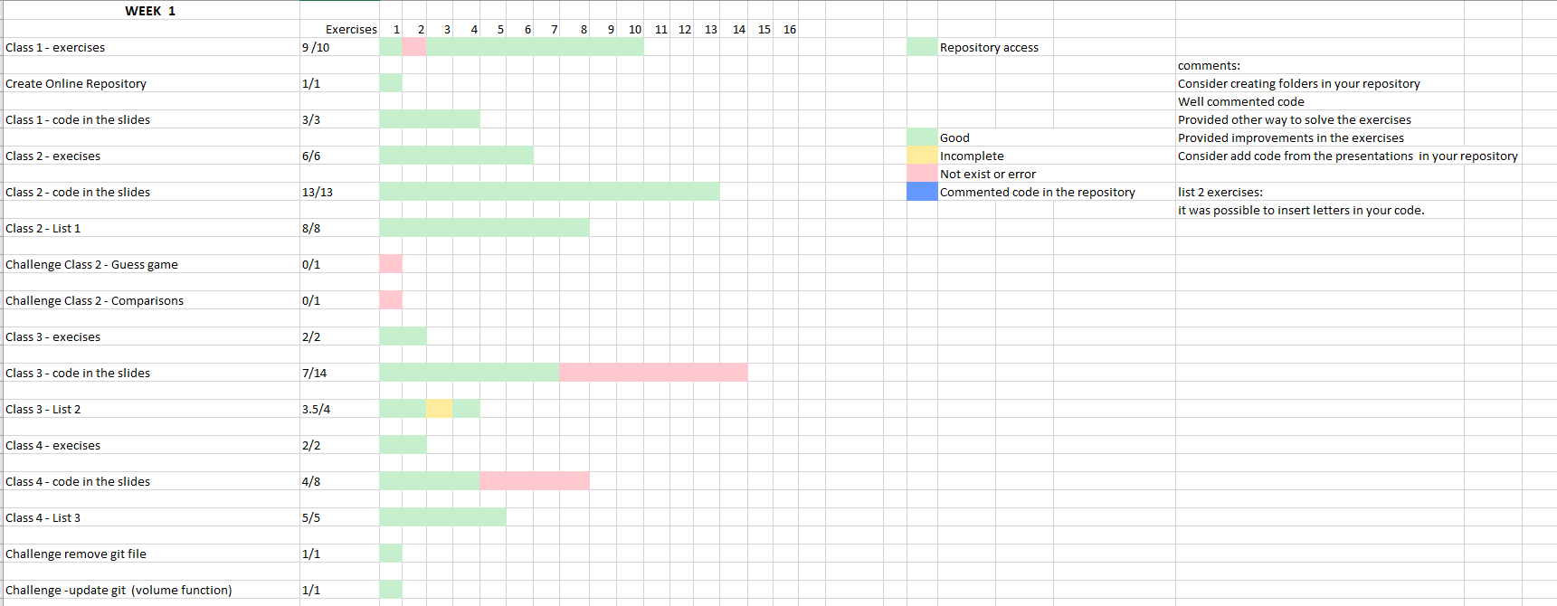

Evaluation - Week 1

Slide 3
Comments on the repository organization
Comments on the exercises
List 1 - exercise 1
List 2 - exercise 1
List 3 - exercise 3

Slide 4
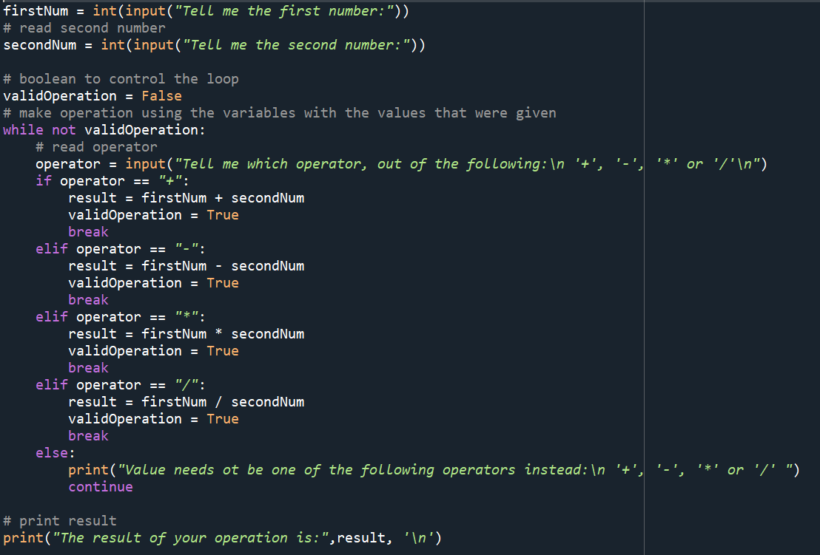
List 2 - exercise 1
firstNum = int(input("Tell me the first number:"))
# read second number
secondNum = int(input("Tell me the second number:"))
# boolean to control the loop
validOperation = False
# make operation using the variables with the values that were given
while not validOperation:
# read operator
operator = input("Tell me which operator, out of the following:\n '+', '-', '*' or '/'\n")
if operator == "+":
result = firstNum + secondNum
validOperation = True
break
elif operator == "-":
result = firstNum - secondNum
validOperation = True
break
elif operator == "*":
result = firstNum * secondNum
validOperation = True
break
elif operator == "/":
result = firstNum / secondNum
validOperation = True
break
else:
print("Value needs ot be one of the following operators instead:\n '+', '-', '*' or '/' ")
continue
# print result
print("The result of your operation is:",result, '\n’)
Expected exercise
Well commented code

Slide 5
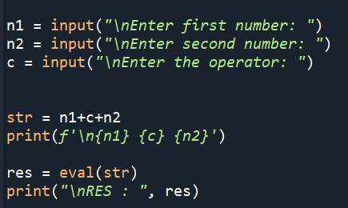
List 2 - exercise 1

Slide 6
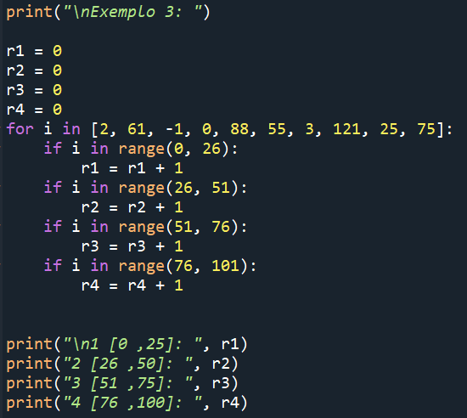
List 3 - exercise 3

Slide 7
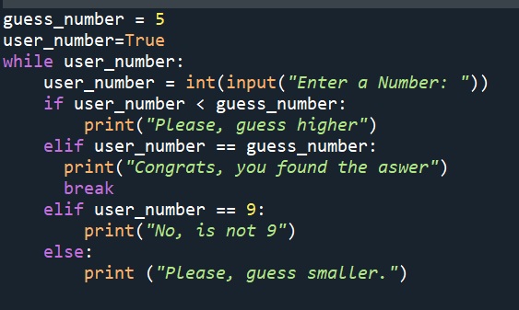
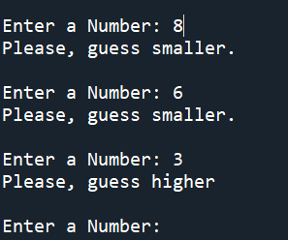
Guess game

Slide 8
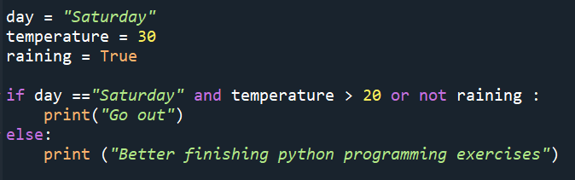
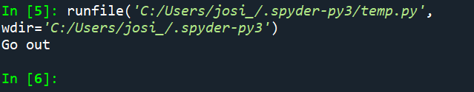
Be careful using conditionals

Slide 9
Other comments?

Slide 10
You can only solve the problems quickly if you’ve already solved the problem/ seen the problem solved before.

Slide 11

<WELCOME >
<Revision>

Slide 12
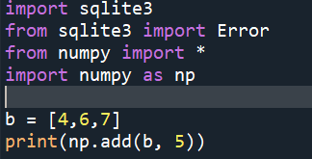
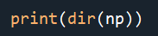
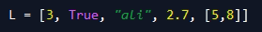
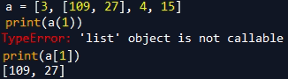
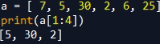
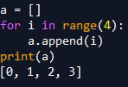
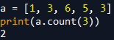
Importing modules
Finding functions attributes
Documentation
List: <identification> = [<value1>, <value2>]
Accepts different variable types
Index to access and/or find members
Cannot change strings in lists using indexes
Ordered
usually for loop is used to manipulate lists
It is possible to make slicing
it is possible to concatenate lists with * and +
in and in not indicates membership
it is possible to include a list inside other list
Lists have methods such as .pop(), insert(),
count(), append()
Filtering

Slide 13
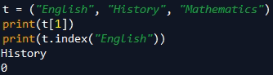
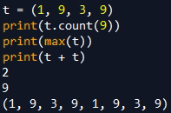
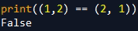
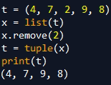
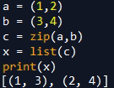
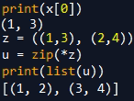
Tuple: <identification> = (<value1>, <value2>)
Index to access and/or find members
Cannot change strings in tuples using indexes
it is possible to concatenate lists with * and +
Ordered
it is possible to use python build in functions to manipulate tuples
Lists have methods such as .count(), .index(),
Removing member is only possible by converting to another type
It is possible to save tuple member in other variables - unpacking
A look in zip(),

Slide 14
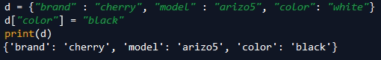
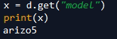
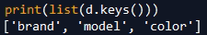
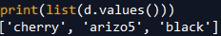
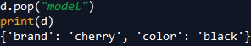
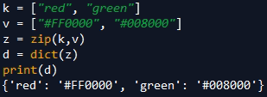
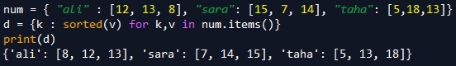
Dictionary: <identification> = {<value1>: <value2>,
<value3>: <value4> }
Dictionaries have methods such as .get(), pop(), .popitem(), .copy(), .update()
It is possible to use python build in functions to manipulate dictionaries sum().
Sorting using operator module

Slide 15
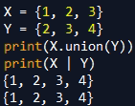
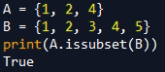
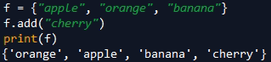
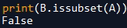
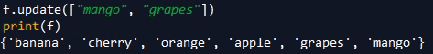
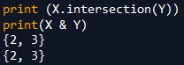
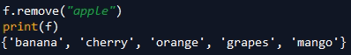
Set : <identification> = {<value1>, <value2>,<value3>}
Add values in the dictionary
Lists have methods such as .add(), update(), .remove(), .copy(), .update()
joint theory
Subset

Slide 16
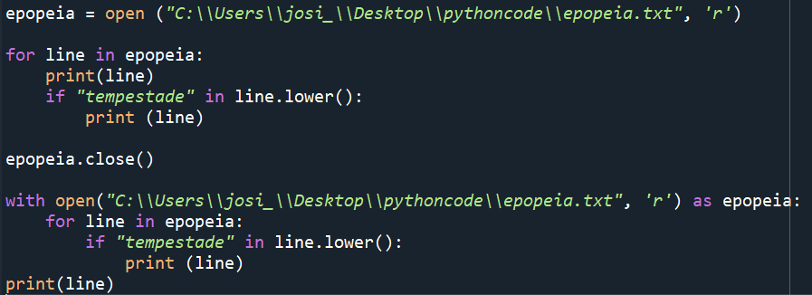
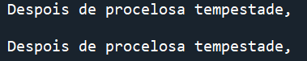
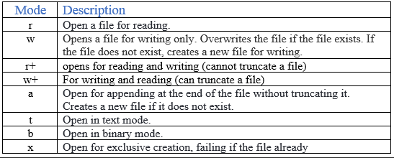
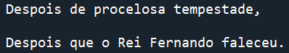
Files:
Open files open(), .close()
open(<path to the file>, <Mode>)
With open takes care of closing files
Output :
Output :

Slide 17
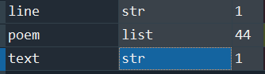
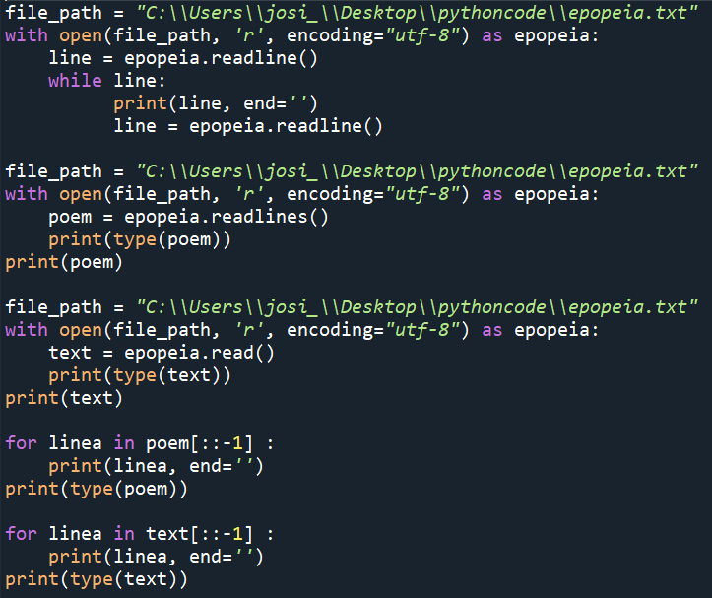
Files:
manipulating files .read(), .readline() .readlines()
readline() – Reads a single line of the file and return a string
readlines() – reads the entire file and return a list of strings
read () – reads the entire file and return a string
Variables:

Slide 18
Files:
Json files – JavaScript Object Notation file – easy to understand by human and machines
{
"data": [ {
"id": "12341 ",
"name ": "Joseanne Viana",
"address": {
"city": "Lisboa",
"state ": "Lisboa ",
"postal_code":"1000569"
},
"position ": "PhD Student "
}
] }
Data is separated by commas.
Curly braces hold objects.
Square brackets hold array
https://jsonlint.com/?code=

Slide 19
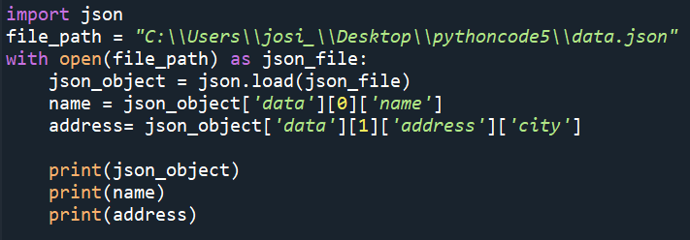
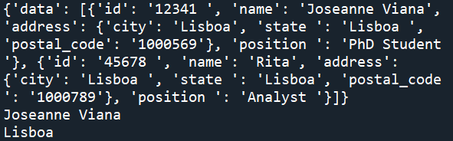
Files:
Json files – import json packet
open (<path to the file >) json.load(<object>),
json.dumps(<pythonObject>, <formatting attribute>) – convert python objects in json objects
json.dump((<pythonObject>, <fileObject>, <formatting attribute>) ) – write json files
Output :

Slide 20
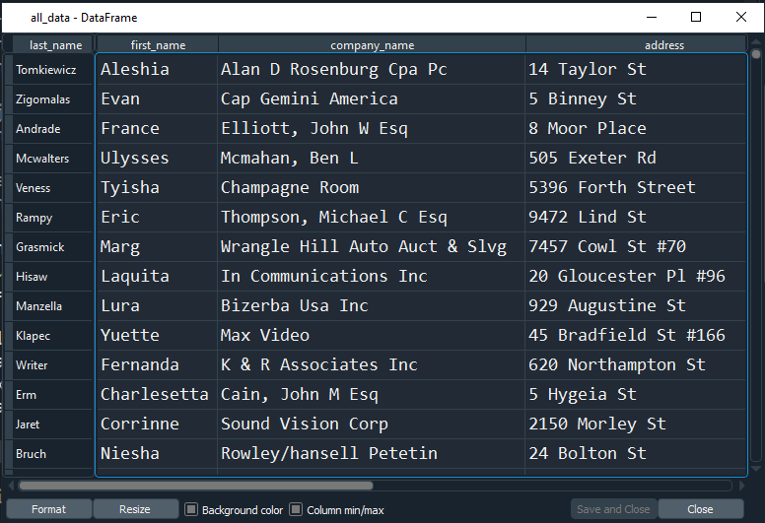
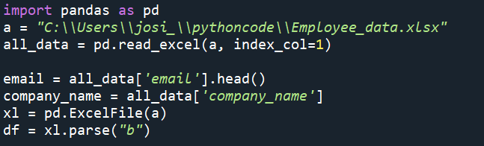
Files:
Excel files
Pandas packet is frequently used to manipulate excel files
Output :

Slide 21
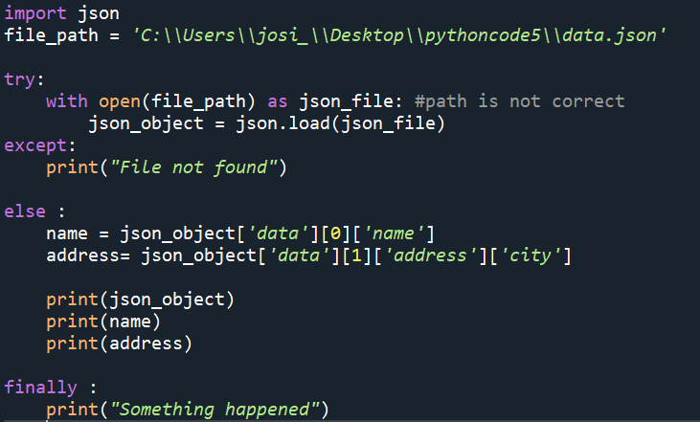
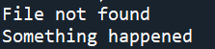
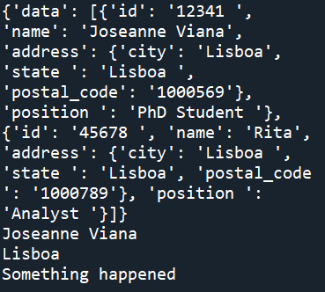
Try, catch, else, finally
Accessing code from other libraries outside of python, text files, databases
#Path is not correct
#Path is correct

Slide 22
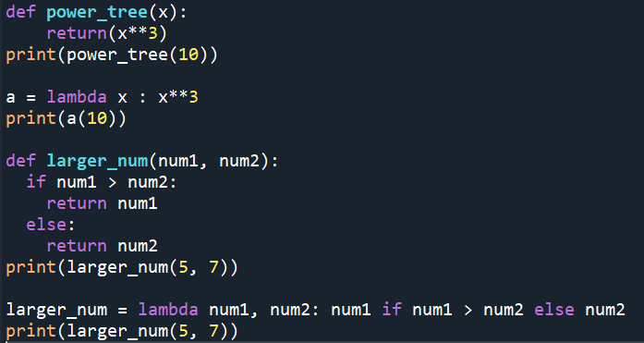
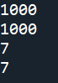
Lambda expressions,
Lambda function also called anonymous function
Can receive any number of arguments, but can only have one expression
lambda <arguments>: <expression>
Output :

Slide 23

Maps:
Perform an operation and return it value in a list
Output :

Slide 24


Filter:
Perform an operation and return it value in a list
Output:

Slide 25


Classes:
Object oriented programming
Aims to combine data and processes related to that data (objects)
The __init__() method is called a constructor method
The increase() method increments the value of the attribute val by 1.
The show() method displays the value of the attribute val
Output :

Slide 26



Creating new module
Create a project called - Area
Create a file called –Geometry calculations

Slide 27




Creating new module.py
Create a new project – named “Drawing”
Different folders
Adding to the PythonPath: Tools > PythonPath

Slide 28
<WELCOME >
<Exercises>

Slide 29
Exercise 1
- In the module that we created, provide operations with circles, namely, calculation of the perimeter and area given the radius. Add the sphere volume function code in your module - Provide operations with squares, namely, calculation of the perimeter and area given the length of the side. Provide the possibility to ask the user for a value and writes on the screen the perimeter and the area of the circle and square based in the radius and side measurement.

Slide 30
Exercise 2
Write a function that takes as a parameter a list of integers. The function must return a tuple with two integer values f1 and f2, where f1 is the list element with lowest frequency (lowest number of occurrences in the list) and f2 is the element with the highest frequency. Tip: use a dictionary to compute the frequencies of the list elements. The following function must be implemented:
def frequencies (v)
Input = [1, 4, 5, 1, 6, 3, 2, 1, 2, 9, 1, 4, 6, 3, 9]
Output = ([f1], [f2]) f1 = [5,7] f2=[1]
def frequencies (v)

Slide 31


